Slide 1
Exploratory Data Analysis – Bureau Tables
Over 85% of consumers have data in Bureau dataset
Over 600,000 instances of active credit, allowing us to use that subset for feature engineering
Bureau Balance contains new information on .2% of consumers, limiting its usefulness for feature engineering

Slide 2
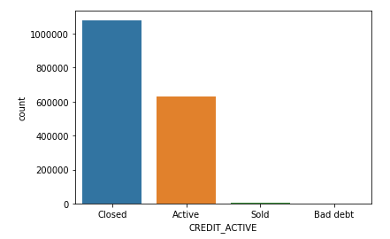
EDA: Bureau Table Count of Active Credit
EDA

Slide 3

Feature Engineering – Primary table
Feature Engineering
Percentage of the loan annuity relative to a client's income using AMT_ANNUITY and AMT_INCOME_TOTAL
Length of the payment in years using AMT_ANNUITY and AMT_INCOME_TOTAL
Percentage of the days employed relative to the client's age (after imputing anomalous values in 'DAYS_EMPLOYED’)
Percentage of the goods price relative to the loan credit amount using AMT_GOODS_PRICE and AMT_CREDIT
Income per family members based on CNT_FAM_MEMBERS.
Total number of enquiries to Credit Bureau by adding individual counts from day, week, month and year.

Slide 4

Feature Engineering – Previous Application table
Feature Engineering
Group by client ID and calculate all aggregate statistics
Count of previous approved applications
Count of previous rejected applications
Difference between applied and approved credit
Aggregating AMT_ANNUNITY and AMT_APPLICATION
Prev_GOODS_PRICE_CREDIT_PERCENT: percentage of goods price relative to the loan credit amount
Prev_CREDIT_APP_PERCENTAGE: percent of credit granted relative to loan applied for
Calculate privileged interest rates, termination days, and last days due after application

Slide 5

Feature Engineering – Installment Payments table
Feature Engineering
Difference between the prescribed and actual installment amount.
Difference between the prescribed and actual days of repayment.
Percentage of amount paid relative to the installment.
Percentage of days paid relative to days installment.
Percentage of the installment difference relative to the amount.
Installment days paid late and overpaid.

Slide 6

Feature Engineering – Credit Card Balance table
Feature Engineering
Credit utilization: the ratio of monthly balance and credit limit
Total number of days past due (w/tolerance) for all previous credits.
A total count of all drawings of all types.
The percentage of amount for a number of features relative to credit limit:
All current types of drawings
Payments and current payments
Receivable and receivable principal

Slide 7

Feature Engineering – Additional tables
Feature Engineering
Bureau dataset:
Total of active credit amount and outstanding debt for each consumer
How many days it has been since the most recent credit activity for each consumer
Percentage of each credit that is overdue
Percentage of the credit max that is overdue
Amount of credit closed
POS_CASH_balance dataset:
Percent of remaining installment
The number of installment days remaining
Total number of days of credit past due

Slide 8
Feature Selection: p-values
Significance level is used to determine which features contribute beyond just random noise. Set at .05.
Used two methods: the ANOVA F-test and the Chi-Squared test to generate p-values.
Most significant features identified are similar to each other and other methods.

Slide 9
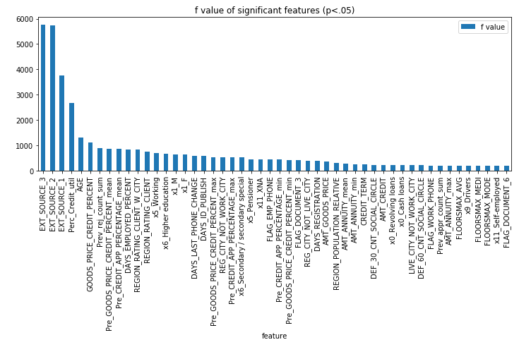
Feature Selection: ANOVA F-test
Feature Selection

Slide 10
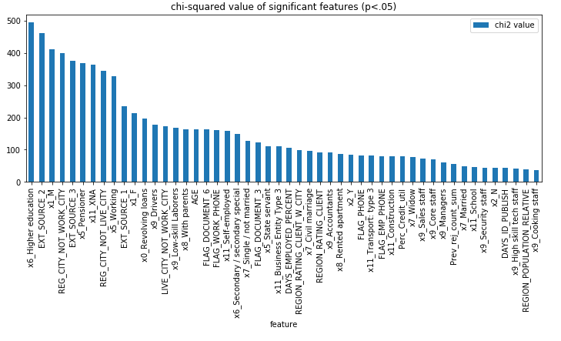
Feature Selection: Chi-Squared Test
Feature Selection

